Slide 1
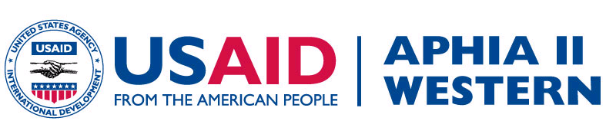
Integrated Health Programs for Women and Children: Lessons from the Field
Dr. Ambrose Misore
Project Director, APHIA II Western, PATH’s Kenya Country Program

Slide 2
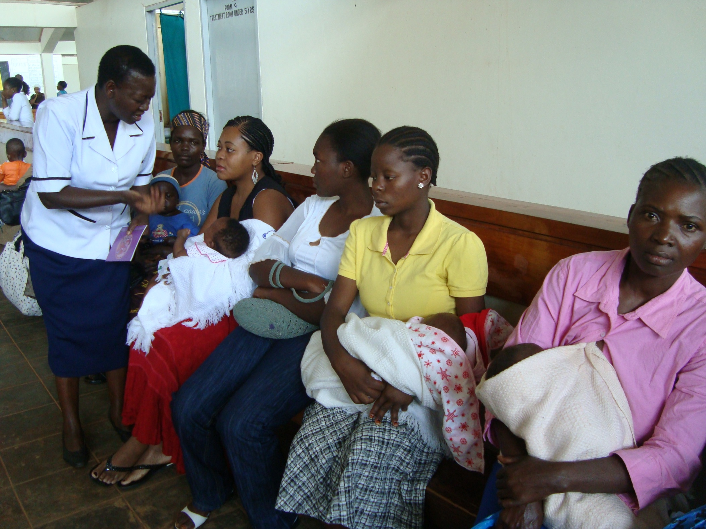

Slide 3
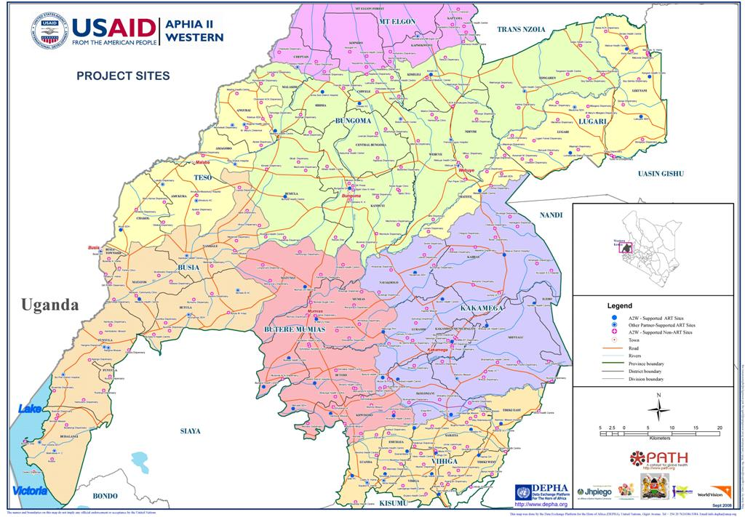

Slide 4
Introduction
1.4 million adult Kenyans are living with HIV/AIDS.
HIV/AIDS prevalence among pregnant women is 9.7%.
In 2008, there were approximately 110,000 pregnant women living with HIV in need of drugs to prevent transmission of the virus to their children; an estimated 56% of this group received the lifesaving regimens.
During the same period, only an estimated 39% of infants born to women living with HIV received drugs to prevent transmission, and treatment coverage was approximately 42% among Kenyan children in need.

Slide 5
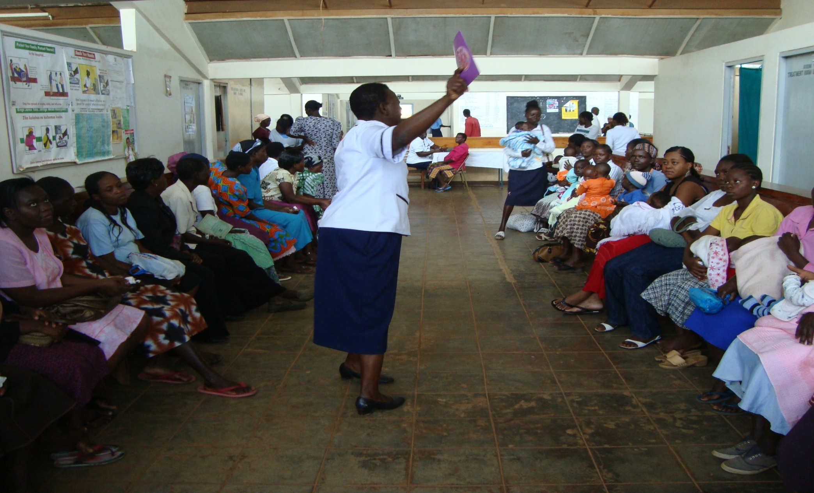
Maternal and Child Health Clinic

Slide 6
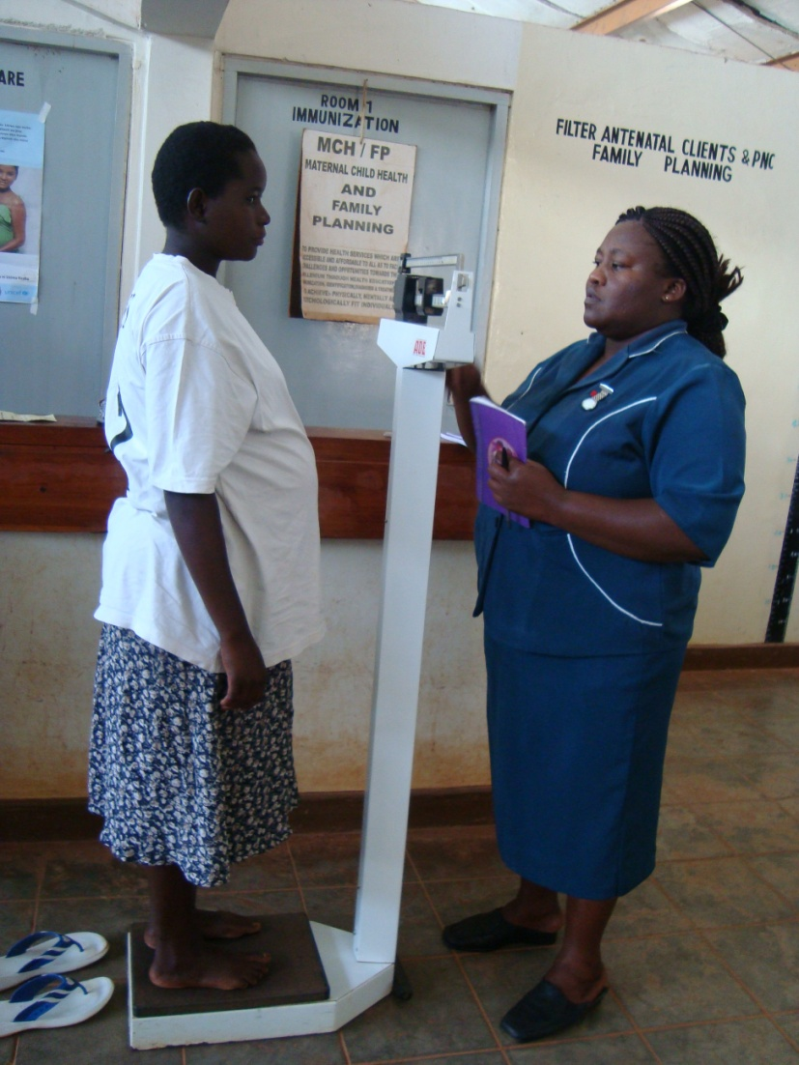
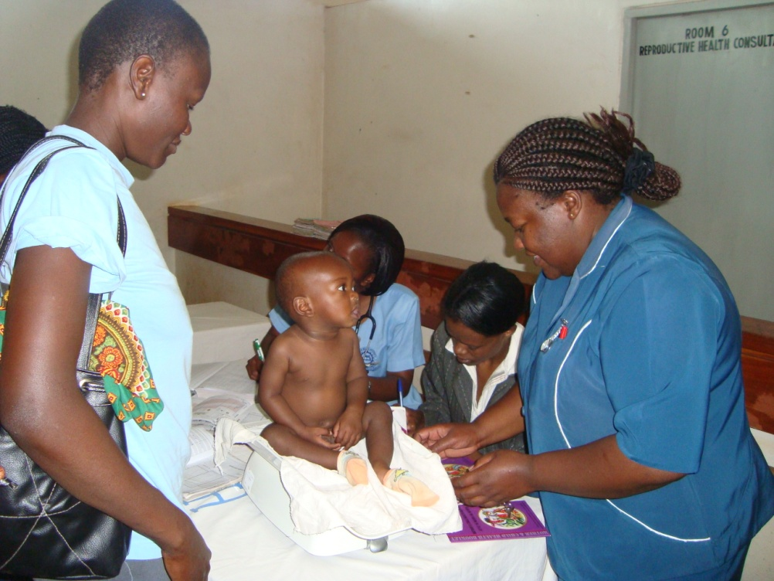
Maternal and Child Health Clinic

Slide 7
Why focus on integration
Weak referral linkages.
Low enrollment of mothers and babies into care and treatment for HIV/AIDS.
Missed opportunities to enroll women into family planning services and children into immunization services.
Maximize use of scarce human resources.
Reduction of time required by mothers seeking care from multiple providers.

Slide 8
What does integration mean?
Integration means a one-stop shop that allows a mother/infant pair to receive routine HIV monitoring and follow-up care in the same location.
All other medical services (e.g. immunizations, prenatal visits, nutrition, family planning) are provided in the same unit.
It is a model for maternal and child health to serve as a one-stop-shop.

Slide 9
Objectives for integration
To maximize utilization of the available resources.
To support overall efforts to decentralize HIV/AIDS care and treatment services to other service delivery units.
To have all HIV positive mothers with their babies younger than 18 months access pre and postnatal care within the integrated setting.
To improve transfer of clients from maternal and child health clinic after 18 months to the other service delivery points within the facility.
To have HIV positive mothers access postpartum family planning services.
To have all HIV positive mothers access cervical cancer screening services.
To ensure that HIV positive babies get quality care and monitoring.

Slide 10
Strategies of integration
Identification of HIV-positive women and exposed babies.
Provision of HIV care and treatment within integrated care setting, including routine monitoring and follow-up visits for up to 18 months postnatal.
Provision of HIV prevention, care, and treatment services to male partners and other children as appropriate.
Family-centered approach to psychosocial support groups and peer counselors.

Slide 11
Package of Services Offered in the Integrated Model
Health education on safe motherhood practices
Collection and testing of CD4 cell counts and other routine care and treatment monitoring tests
Immunization and provision of vitamin A supplementation .
Treatment of opportunistic infections
Assessment of client eligibility for treatment of HIV disease.
Screening for TB
Family Planning
Cervical cancer screening and referral
Food supplementation
Growth monitoring and infant feeding counseling
Support and maintaining psychosocial support group and peer counselors

Slide 12
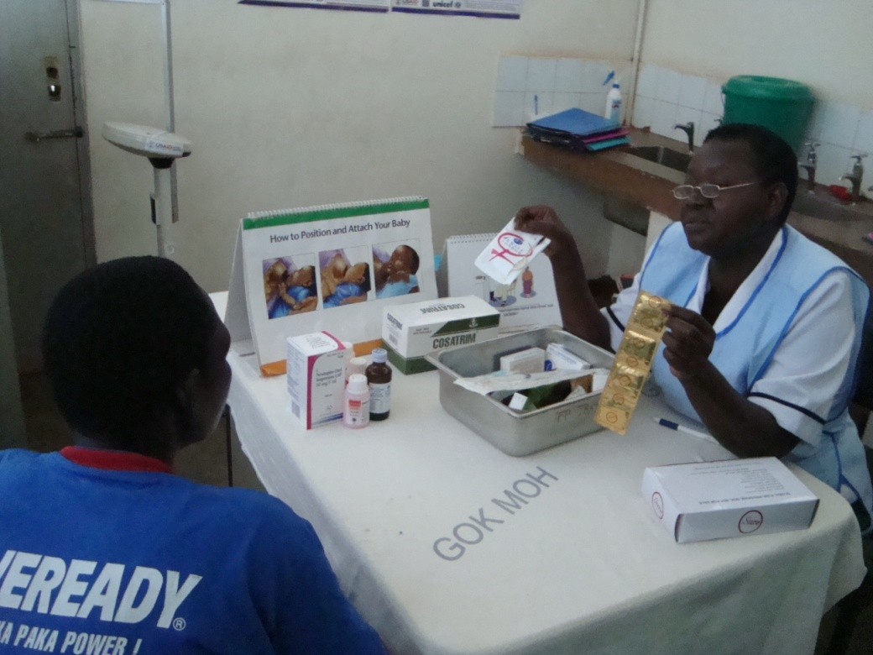
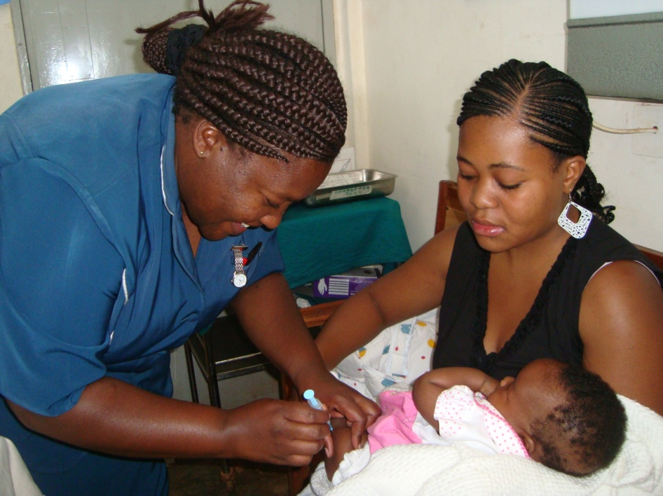
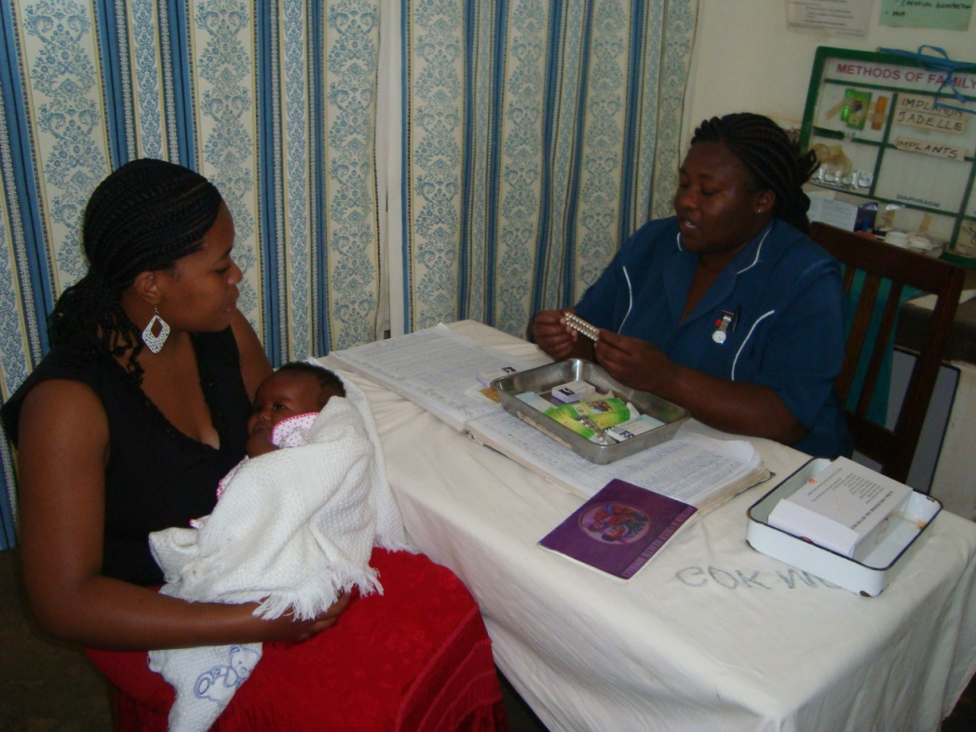
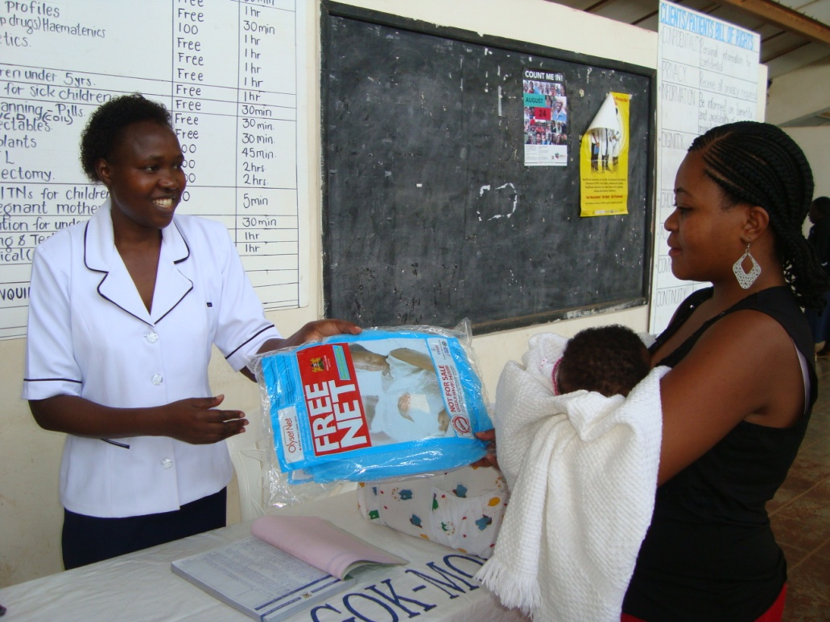

Slide 13
Implementation achievements
After initiating integrated care and treatment, the following successes were recorded
Increase between 80%-100% in percentage of HIV positive mothers enrolled into care.
Average increase of 15% to 30% in percentage of HIV positive mothers who accessed baseline CD4 test.
Increased access to family planning services.
Male involvement in maternal and child health services increased.

Slide 14
Challenges
The key challenges:
Staff skill levels and health care worker shortages
Effectiveness of adherence counseling
Transition of mother/infant pairs to the integrated model

Slide 15
Conclusion
.
The APHIA II Western model has demonstrated successful integration by:
Increasing access to treatment and care for women and babies.
Providing a one-stop-shop for health services for women and children.
Implementing a women and family-centered approach to health.

Slide 16
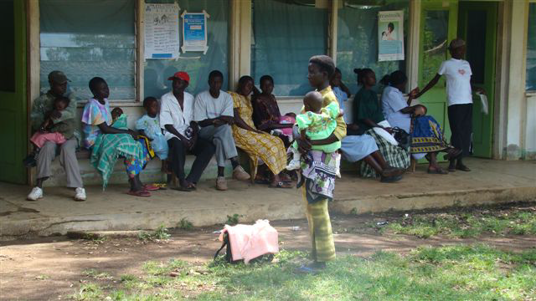
Asante sana
Thank you

