Slide 1
Strengthening Health Services and Communities to Improve Lives of Women and Children in Afghanistan
Koki Agarwal
Director, USAID’s Maternal and Child Health Integrated Program
Jhpiego

Slide 2
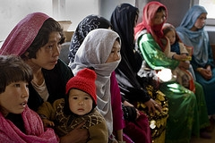
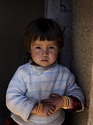
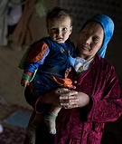
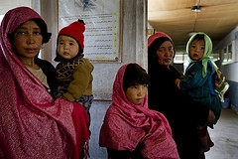
The story of Gulnaaz

Slide 3
Afghanistan in 2002
Country with the second highest maternal death ratio in the world—1,600 per 100,000 live births
There were only 467 midwives for a country with a population of 21 million
No health policies, guidelines and training for several years
No community engagement or ownership of health programs

Slide 4
The Response
Strengthened health system with USAID-funding
Supported Ministry of Health to set a new standard:
Revised and improved guidelines, policies and training
Built a community response to maternal deaths
Provided basic package of integrated services at the primary care level through NGOs
Increased significantly coverage of midwifery services across country and use of skilled attendants at births, from 8% to 19% in just four years
Notes:
8% to 19% increase reflects years 2002-2006

Slide 5


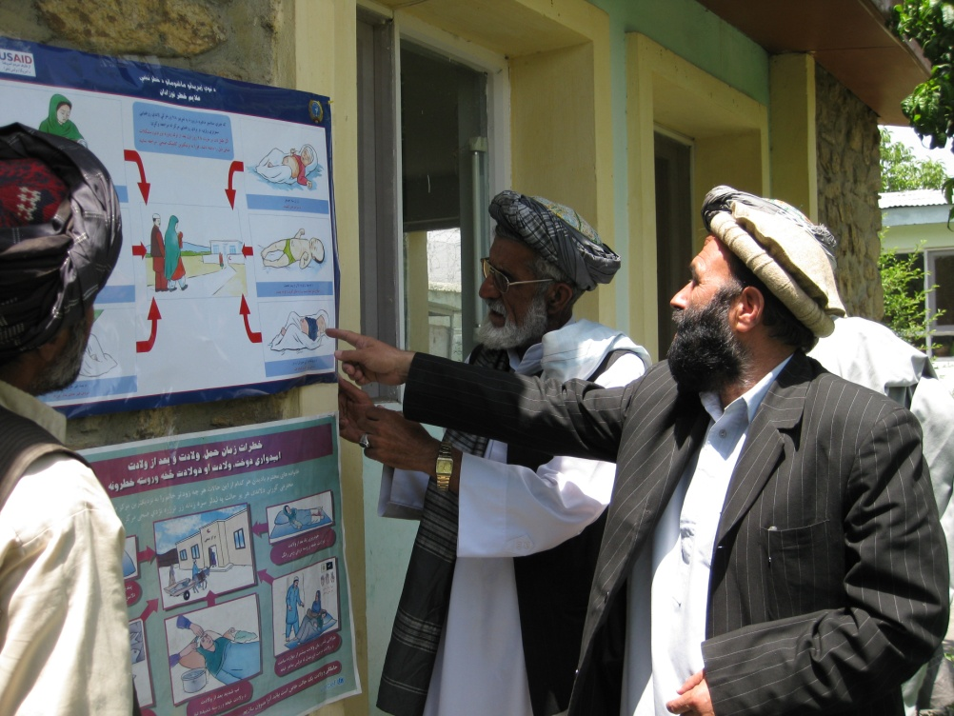
The Health Services Support Project
Founded on the following principles:
Encouraging local ownership of health care delivery and an investment in country-led plans
Developing the ability of local NGOs, the Afghan Midwives Association and other Afghan organizations to deliver and support quality health care services

Slide 6
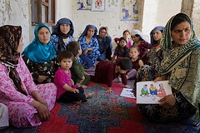
The Health Services Support Project
Building the capacity of the MoH to develop and implement policies and standards
Strengthening health care systems: trained health worker has skills, incentives, equipment to deliver the care people need
Women- and girl-centered approach to benefit families and communities
Notes:
HSSP is systematically strengthening the capacity of 17 NGOs (predominately local Afghan NGOs) in 18 provinces in order to improve the quality of delivery of the Basic Package of Health Services and provides grants and technical assistance to NGOs to implement 14 midwifery schools
Founded in 2005, the AMA now has a membership of over 1,600 midwives and students and 30 provincial chapters. Roles are: advocacy, professional development and support to midwives.

Slide 7
Results: A Multiplier Effect
Jhpiego assisted the Ministry of Public Health in adapting maternal and newborn health strategies for its use (community-based approaches, PPFP, Midwifery education, Quality Assurance Stds).
The MoPH adopted these interventions as national standards and required their use by all donors and organizations working in maternal and newborn health across Afghanistan.

Slide 8
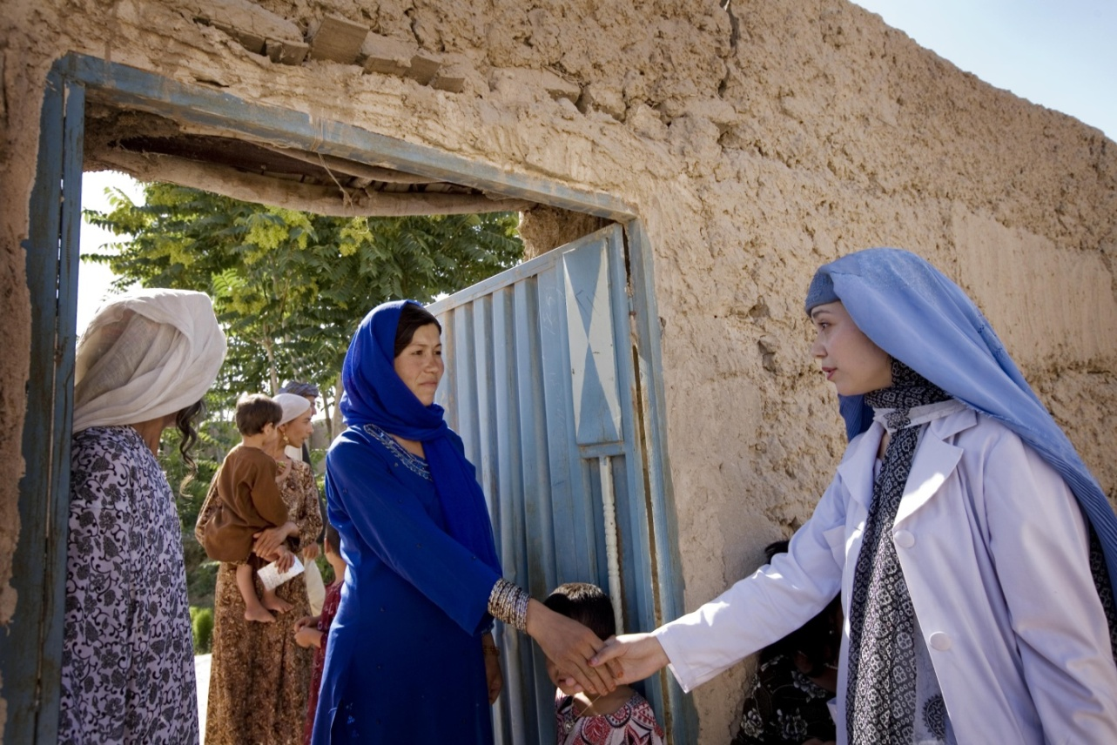
Midwife Frozan Ahmad June 2010
“I remember women who have died in their homes because there has been no midwife to help them deliver their babies….
I really like being a midwife and being able to help women in my community.”
“

