Slide 1
Midlife Women’s Health
Margery Gass, MD, NCMP
Executive Director
The North American Menopause Society
Consultant, Cleveland Clinic Center for Specialized Women’s Health
Clinical Professor Case Western Reserve University School of Medicine

Slide 2
Where to Start?
OBESITY
Hormone Therapy
Alzheimer’s
Breast Cancer
Heart Disease
Mammogram Controversy
Osteoporosis
Over Testing

Slide 3
Menopause!
A normal and natural event
Average age 51 (41-55)
Symptoms: irregular menses, hot flashes, vaginal dryness (discomfort with intercourse)
Hot flashes: 75% of women, 25% severe
Most effective treatment: hormone therapy

Slide 4
Midlife health by age
40
45
50
55
60
65
70+
● Hot flashes
● Final period
● Vaginal discomfort
● Heart disease
● Osteoporosis

Slide 5
Filling in Details
Osteoporosis
Over Testing
Hormone Therapy

Slide 6
Off the Radar
Osteoporosis
Over Testing
Hormone Therapy
Hormone Compounding

Slide 7
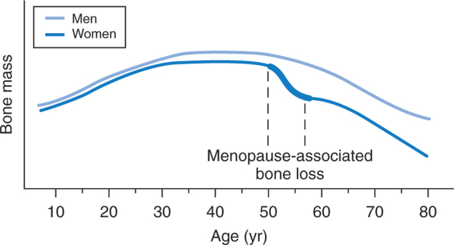
Bone Mass by Age & Gender
Katz: Comprehensive Gynecology, 5th ed.
Katz: Comprehensive Gynecology, 5th ed.
Katz: Comprehensive Gynecology, 5th ed.
Katz: Comprehensive Gynecology, 5th ed.
?
Katz Comprehensive Gynecology 5th Edition Chpt 42, Mosby 2007.

Slide 8
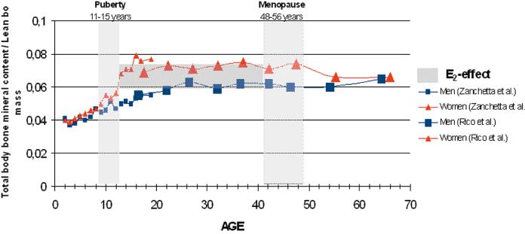
Ratio of Total Body BMD to Lean Body Mass Across Age
Järvinen TL, et al. J Bone Miner Res. 2003;18:1921-1931.

Slide 9
Top 5 “Don’t” List in Internal Medicine
Don't do imaging for low back pain within the first 6 weeks unless red flags are present
Don't obtain blood chemistry panels (eg, basic metabolic panel) or urinalyses for screening in asymptomatic, healthy adults
Don't order annual ECGs or any other cardiac screening for asymptomatic, low-risk patients
Use only generic statins when initiating lipid-lowering drug therapy
Don't use DEXA screening for osteoporosis in women under age 65 years or men under 70 years with no risk factors
http://archinte.ama-assn.org/cgi/content/short/archinternmed.2011.231 Accessed 5-30-2011

Slide 10
Google FRAX
FRAX - WHO Fracture Risk Assessment Tool
Developed by the World Health Organization. FRAX estimates the 10-year probability of fracture.
www.shef.ac.uk/FRAX

Slide 11
5.9
0.6

Slide 12
Hormone Therapy
The Women’s Health Initiative has given us 20 years of research in postmenopausal health
Hormone therapy is a viable option for treatment of menopausal symptoms in healthy early postmenopausal women
Hormone therapy is not recommended for long-term use to prevent chronic diseases of aging

Slide 13
Medical Societies Recommend FDA-Approved HT
Rigorous approval process
Ongoing monitoring of products
Evidenced-based statements on benefits and risks for both the clinician and the patient

Slide 14
Scope of the Problem
The FDA estimated that by 2003 there were 30 million compounded prescriptions written every year
Hormone prescriptions were among the top 3
“Natural” “Safe” “Anti-aging” - No Data

Slide 15
Compounded Bioidentical Hormone Therapy (BHT)
Frequently associated with:
No studies on efficacy or safety
No ongoing monitoring for quality control, purity
No consumer information on risks & benefits
Unsubstantiated health claims
Salivary hormone testing not approved for this purpose
= untested generics
http://www.menopause.org/bioidentical.aspx

Slide 16
Compounded Bioidentical Hormone Therapy (BHT)
There are no data about the number of compounded prescriptions being written.
Solution:
Require reports on the number of prescriptions filled for each product.

Slide 17
Compounded Bioidentical Hormone Therapy (BHT)
Compounded drugs do not meet US standards for
- establishing safety and efficacy
- manufacturing
- labeling for safe use
Solutions
Require safety and efficacy testing for new combinations
Require class labeling for patients
Require reporting of # of prescriptions filled to determine if it is “manufacturing”

Slide 18
Compounded Bioidentical Hormone Therapy (BHT)
Not required to report problems associated with drugs they compound
Solutions:
Require adverse event reporting
Require all compounding pharmacies to be registered with the FDA

Slide 19
Compounded Bioidentical Hormone Therapy (BHT)
Federal legislation is critical to protect women and preserve the integrity of our healthcare system

Slide 20
The Rest of the Story
Osteoporosis
Over Testing
Hormone Therapy
We need to work together….

