Slide 1
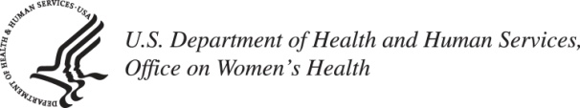
MIDLIFE WOMEN’S HEALTH: A Briefing with Women’s Policy, Inc.
NANCY C. LEE, M.D.
DEPUTY ASSISTANT SECRETARY FOR HEALTH -
WOMEN’S HEALTH
OFFICE ON WOMEN’S HEALTH
U.S. DEPARTMENT OF HEALTH AND HUMAN SERVICES
December 5, 2012

Slide 2
MIDLIFE WOMEN’S HEALTH
CARDIOVASCULAR DISEASE
IN WOMEN

Slide 3
MIDLIFE WOMEN’S HEALTH
CARDIOVASCULAR DISEASE
#1 KILLER OF WOMEN

Slide 4
Age-Adjusted Cardiovascular Death Rates for U.S. Men and Women 2000 and 2007
Rate per 100,000
Sources: Miniño 2000, Xu 2007

Slide 5
Age-adjusted Death Rates for U.S. Women by Race: U.S. 2006
Per
100,000
Women
Sources: Adapted from Lloyd-Jones, Adams, et al (2010).
* CDC Health Data Interactive, 2005-2007.
5
5
Notes:
5

Slide 6
CARDIOVASCULAR RISK FACTORS IN WOMEN
Cannot be changed
Age
Family History
Modifiable
Cigarette Smoking
Diabetes
Hypertension
Obesity
Poor Diet
Sedentary Lifestyle

Slide 7
PREGNANCY AND CVD
A “Metabolic Stress Test”
Risk factors for CVD later in life:
Preeclampsia
Gestational diabetes
Hypertension during pregnancy

Slide 8
WOMEN: Less likely to receive proven interventions than men
cholesterol screening
lipid-lowering therapy
blood thinners and beta-blockers during heart attack
antiplatelet therapy
cardiac rehabilitation
implantable cardioverter-defibrillators

Slide 9
WHAT’S YOUR LEVEL OF CVD RISK?
Are you high risk?
Are you at increased risk?
Are you at ideal CVD health?
Notes:
9

Slide 10
Office on Women’s Health
History: Established in 1991 within HHS to improve women’s health
Mission: Provide national leadership and coordination to improve the health of women and girls through policy, education and model programs

Slide 11
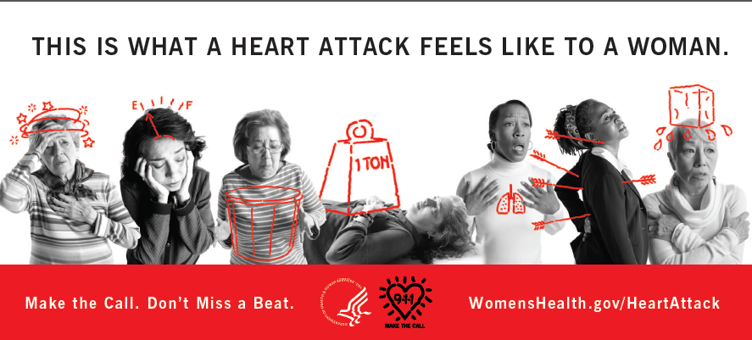
Make the Call. Don’t Miss a Beat. Call 9-1-1

Slide 12

http://millionhearts.hhs.gov

Slide 13

CONTACT INFORMATION
Nancy C. Lee, MD
Nancy.Lee@hhs.gov

Slide 14

WARNING SYMPTOMS OF A HEART ATTACK IN WOMEN
Chest pain, discomfort, pressure or squeezing are the most common symptoms for men and women
Women are somewhat more likely than men to experience other heart attack symptoms, including:
Unusual upper body pain or discomfort in one or both arms, the back, shoulder, neck, jaw, or upper part of the stomach
Shortness of breath
Nausea/Vomiting
Unusual or unexplained fatigue (which may be present for days)
Breaking out in a cold sweat
Light-headedness or sudden dizziness
If any of these symptoms occur,
call 9–1–1 for emergency medical care.
Notes:
08/14/2013
14

