Slide 1
Smoking in African American Women
William B. Lawson MD, PhD, DLFAPA
Department of Psychiatry and Behavioral Sciences
Howard University College of Medicine
Washington, D.C. 20060
(202)865-6611
wblawson@howard.edu

Slide 2
Percentage of U.S. adults who were current smokers in 2010
19.0% of all adults (43.8 million people)
31.5% non-Hispanic American Indian/Alaska Native
27.4% non-Hispanic multiple race
20.6% non-Hispanic white
19.4% non-Hispanic black
12.9% Hispanic
9.9% non-Hispanic Asian

Slide 3
The Good News
African-American women have lower smoking rates than white women.
African American women initiate smoking later than White women at each age group.
More than 50% of all African American smokers use 10 or fewer cigarettes per day and thereby can be described as light smokers

Slide 4
The Bad News
Smoking is the biggest risk factor for lung cancer.
Despite smoking less lung cancer rates for African American women are no lower than white women.
African-American women are more likely to die from lung cancer than white women.
African-Americans who smoke are more likely to develop lung cancer than other smokers

Slide 5
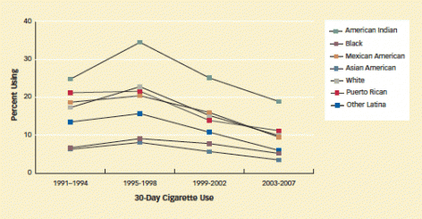
Fewer girls smoke in the eighth grade

Slide 6
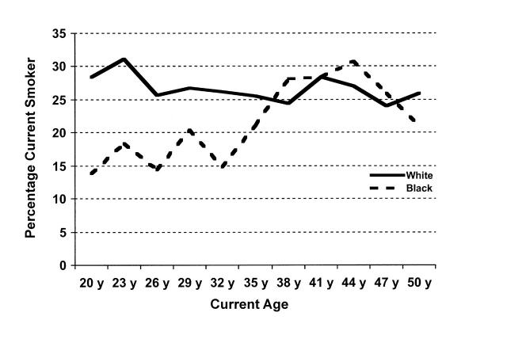
Smoking increases with age for African American women so many are beyond the age to benefit from most prevention programs

Slide 7
More complications
Smoking disproportionately affects groups with limited resources and may increase the likelihood of binge drinking, illicit drug use, or non-medical use of prescription medication.
Depressive symptoms were associated with a higher prevalence of smoking.
Individuals with HIV/AIDS have disproportionately high depression and smoking prevalence rates.
Smoking rates are also much higher in African American females over age 25 years old who have less than a high school education (23.2%) compared to those with a college education (9.5%).

Slide 8
In addition
Interventions, both psychosocial and pharmacological are not as effective in African American women.
African Americans have been targeted by the advertising media. 1998 through 2005, the average youth in the United States is annually exposed to 559 tobacco ads, every adult female 617 advertisements, and every African American adult 892 ads. Money spent on magazine advertising of mentholated cigarettes, popular with African Americans, increased from 13 percent of total ad expenditures in 1998 to 49 percent in 2005.

Slide 9
Minority Representation in Clinical Research
Little data available for clinical trials of recently approved drugs
Handful of studies in light smoking in African American women
Estimated to average substantially less than 5% in pivotal trials supporting drug safety and efficacy
< 1% of studies in biological psychiatry when ethnicity is identified
Less likely to be investigators

Slide 10
Conclusion
Smoking not as common but has equivalent or worse outcomes
Usual interventions may have to be tailored to African Americans or new interventions must be developed
Limited research

