Slide 1
Injection Drug Use and Hepatitis C
What Can We Do About It?
Wilson M. Compton, M.D., M.P.E.
Deputy Director
National Institute on Drug Abuse

Slide 2
Reported Number of Acute HCV Infections by Sex in USA, 2000–2013
Source: National Notifiable Diseases Surveillance System (NNDSS)
Notes:
Incidence rates of acute hepatitis C decreased among males and females from 2000-2003 and remained fairly constant from 2004-2010.
From 2010-2013, rates of acute hepatitis C increased among males and females; in 2013, rates among males and females were 0.8 and 0.7 cases per 100,000 population, respectively.

Slide 3
Injection Drug Use Is Driving new HCV Infections
IDUs are most vulnerable for acquiring HCV
70% of IDUs test positive for HCV
90% of HIV-infected IDUs become co-infected with HCV
Increased IDU due to switch from Rx opioids to heroin
There is a surge in HCV infection within young IDUs (18-25 year old) who transition from Rx opioids to heroin
Most HCV-infected IDUs unaware of infection status
Infected people may be asymptomatic for many years after the initial infection until signs of cirrhosis or liver cancer develop, increasing their risk of transmitting HCV to others.
Notes:
These stats were taken from Jag Khalsa’s contributions to the Viral Hepatitis Congressional Brief.

Slide 4
Outbreak of HIV Linked to IDU of Oxymorphone Indiana, 2015
162 HIV Infections in a Community of 4200
84.4% 114 co-infected with Hepatitis C
109
HIV+
HIV-
121
230 tested
social contacts
regarded as at
high risk for
HIV
108
4
74
54
247 located
syringe-sharing
or sex partners
112
Reported average
of 9 syringe-sharing
partners, sex partners,
or other social contacts
at risk
for HIV infection contacts
128 not located
All reported injecting tablets of oxymorphone As drug of choice
373

Slide 5
HCV, HIV and Opioid Addiction are Part of Syndemic of Intersecting Epidemics
HCV, HIV, and opioid dependence are co-occurring epidemics.
HIV
Treatment of opioid dependence with buprenorphine increases uptake of HAART.
Stabilization of patients using buprenorphine + HAART allows for treatment for HCV coinfection.
Withholding HCV treatment in opioid dependent HIV/HCV coinfected individuals leads to end-stage liver disease, HCC, and liver-related mortality.
Opioid Dependence
HCV
Syndemic
Conditions
Notes:
HCV, HIV, and opioid dependence are co-occurring epidemics. Management of opioid dependence in HCV-infected individuals is critical to optimizing safe HCV treatment, maximizing adherence, increasing health, and preventing post-treatment reinfection, yet many who are also infected with HIV remain untreated for HCV. Buprenorphine, unlike methadone, can be dispensed by health care providers and thus provides an opportunity to integrate HCV and HIV care with addiction treatment in a single outpatient office setting, improving the health outcomes for those at greatest risk for HCV disease. Taylor, et al. (2012) J. Addict. Med. 6(3):179-185.

Slide 6
Upstream Driver of HCV is Rx Drug Abuse: What can be done?
Better access to effective treatments, especially medications for the underlying opioid addiction
Buprenorphine, Methadone and Naltrexone
Less abusable analgesics
Addressing overdose directly
Education
Easy to administer naloxone
Prevention
Enhanced PDMP information
Universal Prevention
Clinician Education
Notes:
Direct to consumer marketing

Slide 7
Some Barriers to Improving Our National Response to HCV in Young Non-Urban IDUs
Acute HCV infection may be asymptomatic (only 10%-20%); young IDUs tend not to seek treatment
Young and nonurban IDUs hardest to reach (only ~12% success rate in doing interviews in Mass.)
There may be no drug treatment availability
There may be no antiviral treatment availability
There may be no interest by IDU in drug/antiviral treatment

Slide 8
New NIDA-Supported HCV Research
NIDA: 2nd largest NIH funder—46 projects, $21.3 M (FY2014)
Interventions for rural, at-risk women; support for women in drug court; financial literacy & vocational training for at-risk women
Rapid HCV testing in care settings
Utilization of case managers within a coordinated care framework
Adaptation of HIV model of “treatment as prevention”
Efficacy of direct acting antivirals in substance using populations
Notes:
FY2015 Viral Hepatitis Congressional Brief – NIDA.
NIDA supports basic and clinical research on HCV mono-infections and HIV/HCV co-infections among IDUs, including:
Testing the accuracy and acceptability of rapid HCV tests in point-of-care settings to more rapidly identify HCV-infected IDUs and link them to care.
Examining coordinated care models that utilize care managers to integrate HCV specialty care within primary care, substance use treatment, and mental health services from multiple, geographically separate providers.
Examining how expanded HCV treatment can prevent further transmission of HCV and HIV/HCV dual infections by extending the successful ‘treatment as prevention’ model designed for HIV.
NIDA just funded an R34 trial planning study to examine the efficacy/effectiveness of newly approved directly acting antiviral (DAAs) for HCV in drug using populations. In addition, a couple of additional studies are in progress at JHU.
FOA PA-14-135/135/137 - “Prevention and Treatment of Substance Abusing Populations with or at risk for HCV” ;expires May 8, 2017.

Slide 9
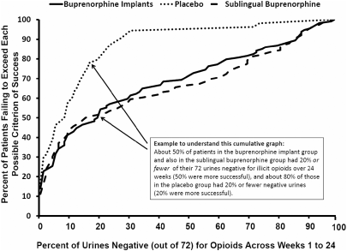
ADDICTION: New Medications
RCT Buprenorphine Implants vs Placebo & Sublingual Buprenorphine/Naloxone
Challenge: Compliance with daily intake
Solution: develop long acting medications
% of Patients Failing to Exceed
Each Possible Criterion of Success
Placebo
Sublingual
Buprenorphine
Buprenorphine Implants
% of Urines Negative (out of 72) for Opioids Across Weeks 1 to 24`
Rosenthal RN et al., Addiction 2013;105: 2141-2149.

Slide 10
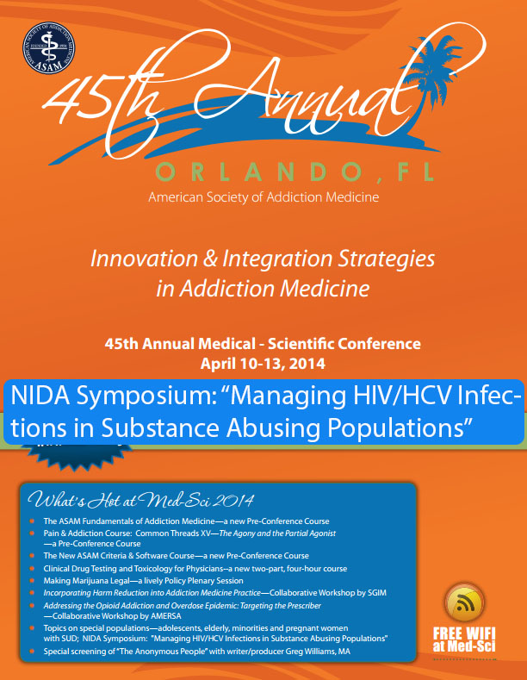
NIDA: Ongoing Efforts in HCV Research
Multidisciplinary approach
2013 Technical Consultation Meeting
NIDA Symposium: “Managing HIV/HCV Infections in Substance Abusing Populations”(ASAM, 2014)
Notes:
FY2015 Viral Hepatitis Congressional Brief – NIDA.
NIDA is supporting multidisciplinary research to address HCV infection in drug using populations, including understanding how the virus is spread, how various drugs affect viral load, progression of viral infection, the impact of substance abuse treatment on HCV infection, and ways to optimize HCV treatment, among others.
A Technical Consultation Meeting sponsored by the Office of the Assistant Secretary for Health (HHS) along with other HHS agencies (CDC, SAMSHA, HRSA, and NIH, specifically NIDA and NIAID) in 2013 brought together experts from a variety of backgrounds to address the emerging HCV epidemic in young IDUs (http://aids.gov/pdf/hcv-and-young-pwid-consultation-report.pdf). The goals of this meeting were to describe the current epidemiology of HCV and IDU; describe intersections and identify knowledge gaps; characterize young IDUs at increased risk for infection; identify prevention strategies that can be implemented in the near term; identify potential information dissemination strategies for patients and health care providers (education); and identify research priorities in a variety of domains.
NIDA supported a Symposium on Treatment Management of HCV Among IDUs, focusing on treatment of HCV in injection drug using populations at the American Society of Addiction Medicine (ASAM) this month (April 2014) in Orlando, FL.

Slide 11
NIH Efforts: NIDDK and NIAID
Hepatitis B Research Network
Supporting follow-up and ancillary studies to completed HCV clinical trials
NIDDK Intramural Program includes research on hepatitis B, C, and D therapy protocols
Supporting development of next generation of HCV antiviral medications
Hepatitis C Cooperative Research Centers
Launched Phase I/II trial for HCV vaccine
NIAID Intramural Program supports multi-faceted research on viral hepatitis
Notes:
From Viral Hepatitis Congressional Brief:
NIDDK:
The NIDDK supports several research programs related to viral hepatitis. For example, the Hepatitis B Research Network has as its goal to advance understanding of disease processes and natural history of chronic hepatitis B, as well as to identify effective approaches to treatment with currently available therapies. The Network brings together clinical centers from throughout the U.S. and Canada. Through partnerships with industry and the CDC, this multi-center Network has initiated five clinical trials and several ancillary studies to date, and is currently enrolling patients in multiple clinical trials in both adults and children with hepatitis B.
Follow-up and ancillary studies of completed clinical trials on hepatitis C in specific patient populations include: the Peginterferon and Ribavirin for Pediatric Patients with Chronic Hepatitis C (Peds-C) trial; Hepatitis C Antiviral Long-Term Treatment against Cirrhosis (HALT-C) trial; Study of Viral Resistance to Antiviral Therapy of Chronic Hepatitis C (Virahep-C), focusing on disparities in treatment response between African Americans and Caucasians; and Adult to Adult Living Donor Liver Transplantation Cohort Study (A2ALL), which is investigating approaches to mitigate recurrent hepatitis C infection after liver transplantation.
The NIDDK Intramural program includes clinical research protocols on therapy of hepatitis B, C, and D.
NIAID:
NIAID research is advancing or has helped to advance the development of new therapeutic agents against the hepatitis C virus (HCV) such as HCV Entry Inhibitor ITX 5061 and HCV Protease Inhibitor Boceprevir. NIAID also continues to support the Hepatitis C Cooperative Research Centers, a network of five centers dedicated to defining successful immune response to HCV infection and to identifying new targets for antiviral drugs, vaccines, and other therapeutic strategies for the prevention or treatment of acute and chronic HCV infection.
In March 2012, NIAID launched a double-blinded, randomized Phase I/II trial (NCT01436357) to evaluate the safety, immunogenicity, and initial efficacy of a vaccine to prevent acute and chronic hepatitis C infection. The study is in progress and expected to enroll approximately 350 participants.
NIAID intramural researchers, whose work has resulted in a marketed vaccine for hepatitis A and an effective hepatitis E vaccine, collaborate with partners worldwide to study the basic immunology and pathogenesis of viral hepatitis. NIAID investigators also are working closely with pharmaceutical companies in clinical studies of HBV and HCV therapies and conducting collaborative studies to improve the overall response rates to HCV antiviral regimens in HCV–HIV-coinfected volunteers. Other important areas of study include the pathogenesis of hepatocellular carcinoma (HCC), 80 percent of which is due to infection with hepatitis viruses, and the search for biomarkers for early detection of HCC.

Slide 12
Viral Hepatitis Action Plan, updated 2014-2016
See also:
Confronting the Emerging Epidemic of HCV Infection Among Young Injection Drug Users
American Journal of Public Health May 2014; 104:816-821.
Authors from HHS Office of HIV/AIDS and Infectious Disease Policy, NIDA, CDC, SAMHSA

Slide 13
www.drugabuse.gov

