Slide 1
Hepatitis C: The Silent Epidemic
Wednesday, October 21, 2015
John W. Ward, M.D.
Division of Viral Hepatitis
Centers for Disease Control and Prevention
Division of Viral Hepatitis
National Center for HIV/AIDS, Viral Hepatitis, STD and TB Prevention

Slide 2

Hepatitis C Virus ( HCV)
Modes of Transmission
Virus discovered in 1989
Blood–borne transmission
  Health care exposures: Common prior to 1989
  Injection drug use: Highest risk population
Other modes
  Sexual: Heterosexual is rare
  Perinatal: ~5%-12%, transmission risk; ~12% if mother is HIV+
Other sources reported
  Non-injecting drug use (e.g., inhaled drugs)
  Household exposures
  Unregulated tattooing
Scheinmann, Drug and Alcohol Dependence 2006. Weinbaum ,MMWR 2003. Gough, BMC Public Health 2010. Mast, J Infect Dis, 2005. Marincovich B, Sex Transm Infect 2003. Yaphe S, Sex Transm Inf 2012. Bottieau, Eurosurveillance 2010. Ackerman Z, J Viral Hepat 2000. Tohme RA, CID 2012 ; CDC/hepatitis.gov; CDC MMWR 2001

Slide 3
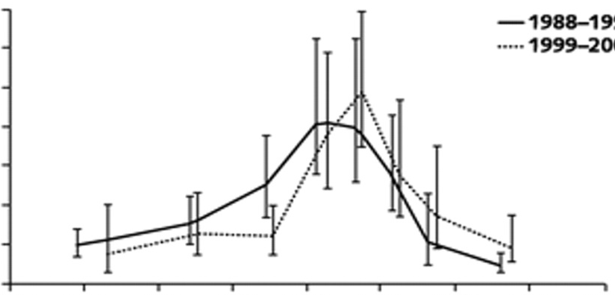

Twin Epidemics of HCV Transmission and Disease
Rising Number of New Acute HCV Cases Related to Injection Drug Use
HCV Seroprevalence Highest for Persons Born 1945-1965
7.0
1965
6.0
5.0
Proportion Anti-HCV-Positive, %
4.0
3.0
2.0
1.0
0.0
1910
1920
1930
1940
1950
1960
1970
1980
1990
Year of Birth
5 fold higher prevalence than others (3.4%)
81% of all HCV-infected adults
73% of HCV-related deaths

Slide 4
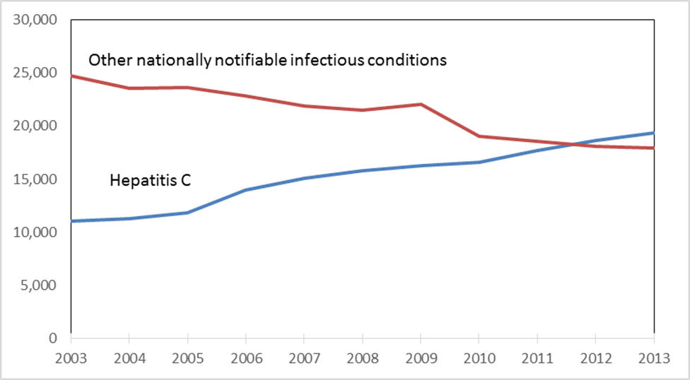
HCV Deaths and Deaths from Other Nationally Notifiable Infectious Diseases,* 2003- 2013
* TB, HIV, Hepatitis B and 57 other infectious conditions reported to CDC
Holmberg S, et al. “Continued Rising Mortality from Hepatitis C Virus in the United States, 2003-2013”
Presented at IDWeek 2015, October 10, 2015, San Diego, CA

Slide 5
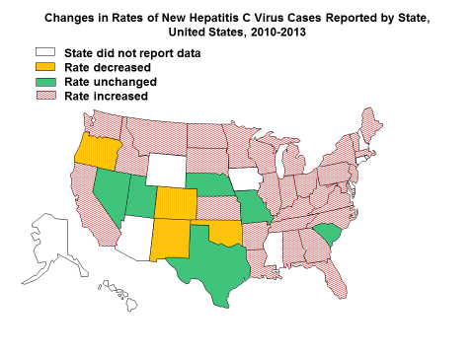
Epidemics of HCV Transmission
Regional Drug Injection Trends Among Persons <30 years old in KY, TN, VA, WV
29,000 new HCV infections in 2013
150% increase since 2010
  Suryaorasad AG, et al. CID 2014, CDC MMWR 2010, CDC MMWR 2011, CDC MMWR 2015

Slide 6

HCV Transmission among
Persons Who Inject Drugs
Transmission risks
  Injection duration
  Frequency of injecting
  Equipment sharing,
  not just sharing needles
Prior to 2006, HCV incidence declined in response to harm reduction for HIV (e.g., syringe services programs)
HCV Case Information
  61% report IDU
  Equally female and male
  Highest rates by age: 20-29 years and by race: American Indian and white
  Increases in suburban, rural areas
Hagan, et al, Int J Drug Policy 2007; Hagan et al, Amer J Public Health 2001.; Lucidarme, et al, Epid and Infect 2004; Burt et al, J Urban Health 2007; Garfein R, J Urban health 2013; Keen L Addict Behav. 2014; Amon JJ, Clin Infect Dis 2008; Kwon et al., JAIDS 2009

Slide 7
Reports of HCV among Pregnant Women, Kentucky, December 2013 – July 2015
HR Sands et al. Perinatal Hepatitis C Surveillance in Kentucky, Dec 2013-July 2015
Notes:
Need to explain HCV antibody+

Slide 8
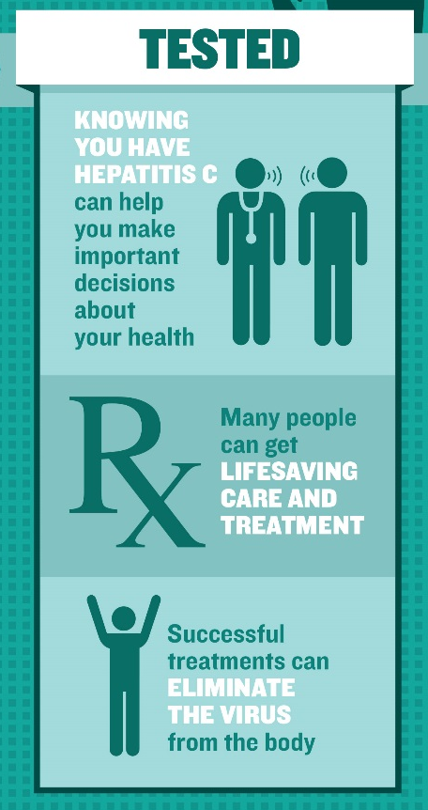


Impact of HCV Testing, Care, and Cure
Test:
  Persons born 1945-1965 (representing 75% of all persons living with HCV infection)
  Persons who inject drugs
Care and Treatment: ~90% cure with one to several pills/day for 8-12 weeks
Benefits:
  73% reduction in liver cancer
  93% reduction in liver-related mortality
Impact:
  Prevention of 321,000 HCV deaths
  Decreased HCV transmission to others
*
van der Meer JAMA 2012; Morgan Ann Int Med 2012; Rein CID 2015; Martin, CID 2013

Slide 9
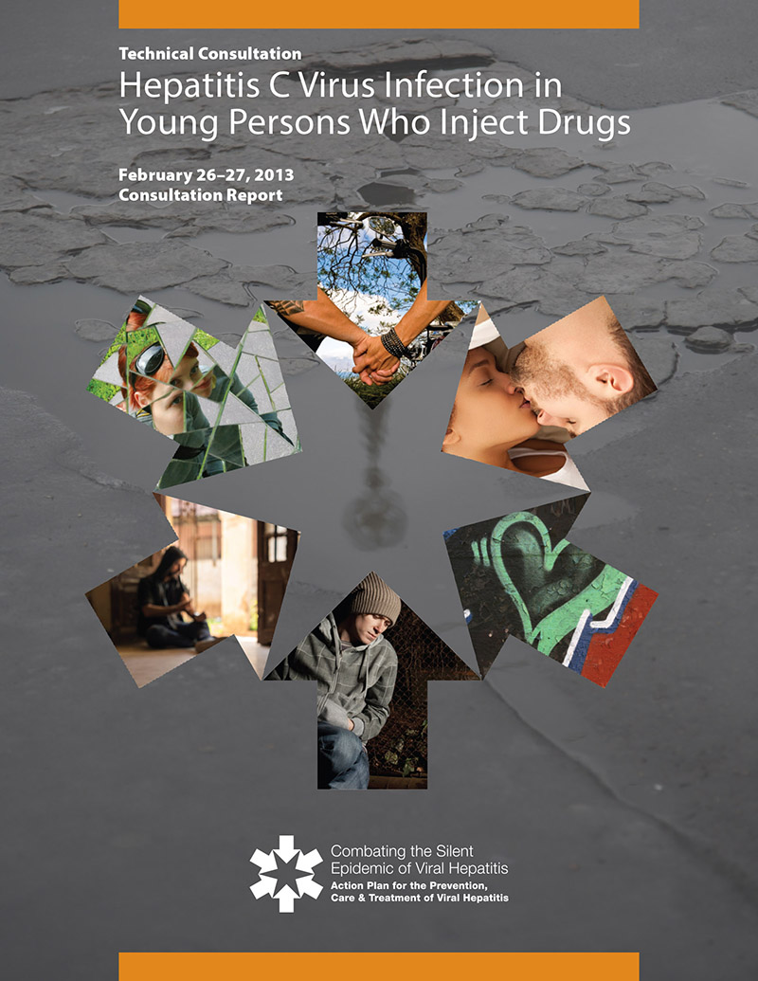
Reducing Viral Hepatitis Cases Associated with Drug-Use Behaviors
  Ensure that persons who inject drugs have access to viral hepatitis prevention, care, and treatment services
  A comprehensive approach is needed, including:
    Regular HCV testing
    Rapid links to care and treatment
    Access to substance abuse treatment, risk reduction counseling, and sterile injection equipment
Notes:
Reference Viral Hepatitis Action Plan – Priority Area 5: Reducing Viral Hepatitis Cases Associated with Drug-Use Behaviors

Slide 10
CDC Activities Addressing HCV in Young Persons
  Assisting with outbreak investigations, including applying advanced laboratory techniques
  Identifying counties at risk for HCV/HIV
  Enhancing surveillance of HCV among pregnant women and newborns
  Studying ways of improving detection of HCV-infected young persons and referring them to care and treatment
  Identifying the best ways to cure persons who inject drugs of HCV and keeping them free from reinfection

Slide 11
CDC Viral Hepatitis Priorities for 2016
Goal: Stop disease transmission and reduce hepatitis B- and hepatitis C-related disability, mortality, and healthcare costs
  Increase hepatitis testing, linkage to care, and treatment— including cure of hepatitis C
  Improve the quality of hepatitis testing, prevention and care, preventing unnecessary deaths
  Reduce new hepatitis C virus infections
  Advance programmatic strategies to eliminate vaccine-preventable hepatitis A and hepatitis B

