Slide 1
Migraine Headache in
Women Veterans Served by VHA
Jason J. Sico MD MHS
National Director, VA Headache Centers of Excellence Program
VA Connecticut Healthcare System
VA Central Office:
Joel Scholten MD, Glenn Graham MD PhD
and Friedhelm Sandbrink MD

Slide 2
VA Headache Cohort Reporting FY2008-FY2021
305,947 Women Veterans with Headache

Slide 3
VA Headache Cohort Reporting FY2008-FY2021
189,368 Women Veterans with Migraine
Notes:
61.89% of women with headache have migraine.

Slide 4
Demographics of Women Veterans with migraine Served by VHA (FY2008-2021)

Slide 5

VHA Visits for Headache by Women with Migraine Diagnoses (FY2008-2019)
93% of women have Primary Care (including Women’s Clinic) visits for headache
55% of women with headache have Primary Care and Specialist visits for headache
38% of women with headache have Neurology visits
26% of women with headache have ER visits for headache
Seng, E., Fenton, B., Wang, K., Lipton, R., Ney, J., Damush, T., Grinberg, A., Skanderson, M., Sico, J. Characteristics, healthcare utilization, and concomitant disorders of people with medically diagnosed migraine in the Veteran’s Health Administration: a national cohort study, 2008-2019. Neurology.

Slide 6
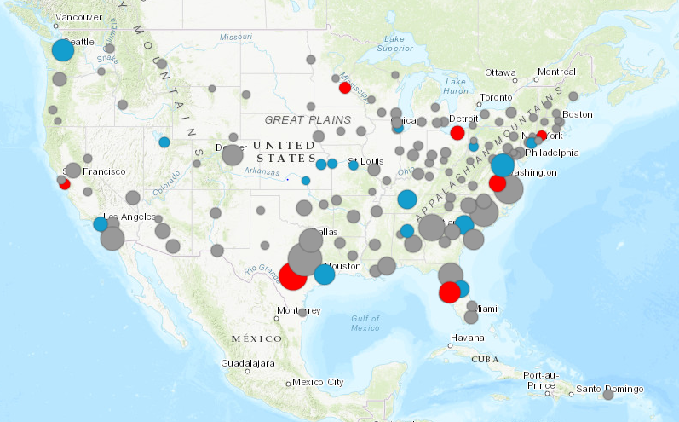
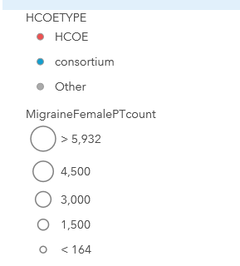
National Picture of Women Veterans with
Migraine in the Headache Cohort
Type of Facility
Headache Center of Excellence
Consortium Site
VA Medical Centers without an HCOE or Consortium Site
Number of Women Veterans with Migraine at Given VAMC
Total Number of Women with Migraine in Cohort
FY 2008-2021: 189,368

Slide 7
Visits by Women Veterans with Headache
Patients are unique within a month only.
One patient may be counted in more than one month, so visits cannot be summed.

Slide 8
VA Headache Cohort Reporting FY2008-FY2021
1,743,922 Total Veterans with Headache
58,939 Matched in Burn pit Cohort
9,240 Women with Headache in the Burn pit Cohort

Slide 9

VHA Visits for Headache in the matched hcoe/burn pit cohort
89.5% of women with headache saw Primary Care
17.6% of women with headache received headache care in the ER
81.3% of men with headache saw Primary Care
11.9% of men with headache received headache care in the ER

