Slide 1
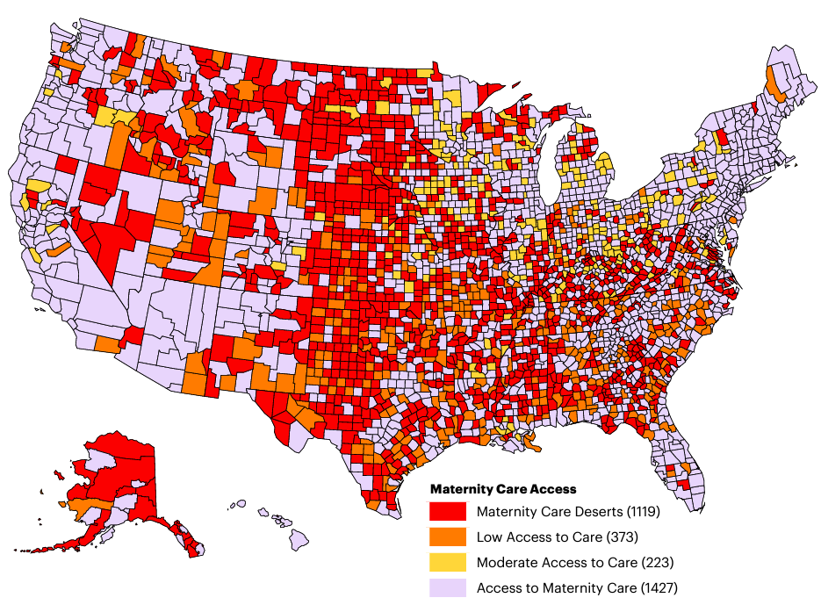
Maternal Health Crisis in the U.S.
More than 2.2 million women live in maternity care deserts (1119 counties)
5% increase between 2018-2020 in counties that have less maternity access
Map Source: U.S. Health Resources and Services Administration (HRSA), Area Health Resources Files, 2021

