Slide 1




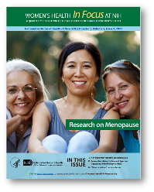



NIH Has Funded Menopause Research for 30+ Years
ORWH: Women’s Health In Focus at NIH
Research on Menopause
Volume 5, Issue 2, 2022
Menopause Strategies: Finding Lasting Answers for Symptoms and Health Trials
Began in 2008
Funded by NIA, NICHD, NCCIH, ORWH
Women’s Health Initiative
Began in 1991
Funded by NHLBI
Menopausal Vasomotor Symptoms and Brain Aging in Women
Funded in 2016 by NIA
Study of Women’s Health Across the Nation
Began in 1994
Funded by NIA
Vivian Pinn Symposium 2023
Menopause and Optimizing Midlife Health of Women

Slide 2
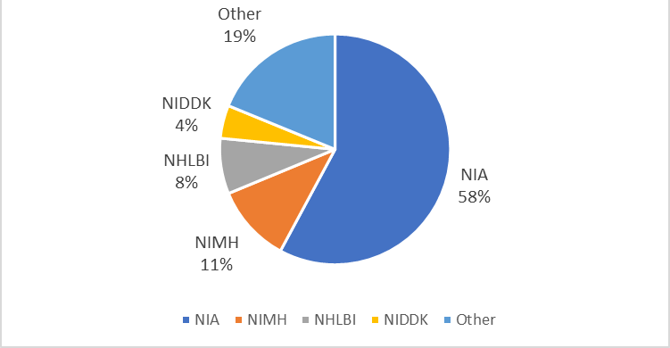
Women’s Health Research on Menopause is Supported across NIH Institutes and Centers
RCDC Menopause Funding by IC FY23 – Total $56 Million Across 127 Total Projects

Slide 3
Sample of Current Research Studies FY23
1
PhytoSERM Efficacy to Prevent Menopause Associated Decline in Brain Metabolism and Cognition: A Double-Blind, Randomized, Placebo-Controlled Phase 2 Clinical Trial
Menopause-related increase in gut leak and its relation to immune activation, bone density decline and fractures
Evaluating the natural evolution of myocardial stiffness in aging, sex differences, and through menopause transition in women, using a free-breathing magnetic resonance elastography approach
Estrogen Declines with Menopause: Impacts on the Medial Temporal Lobe Network and Emotional Memory in Aging Females at Genetic Risk for Alzheimer’s Disease
Estrogen receptor reprogramming ligands for the prevention of protracted menopausal symptoms and chronic diseases
Hot Flashes and Neurovascular Function in Women
2
3
4
5
6

Slide 4

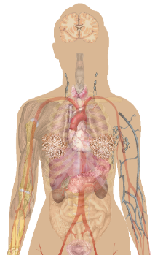


Using Systems Biology to Understand Midlife Health of Women
Metabolic Dysfunction
Cardiovascular Disease
Anxiety, Depression, Substance Use
Frailty & Sarcopenia
Pelvic Floor Disorders
Dementia
Exercise
Quality of Life
Sleep
Nutrition
Microbiome
POSTMENOPAUSE
PERIMENOPAUSE
MENOPAUSE TRANSITION
INTERGRATIVE LIFECOURSE

Slide 5
Gaps in Menopause Knowledge (1)
Diagnosis:
  Are there improved diagnostics by which to assign symptoms (e.g., hot flashes, insomnia) to menopause rather than other conditions (e.g., hypothyroidism mental health disorders)?
  Which biomarkers best predict the timing or duration of menopause and/ or menopausal symptoms?
  Does the severity of symptoms identify women who may be at risk of disease later in life?
Disease Prevention:
  What specific interventions (e.g., medication, nutrition, exercise, mental health) that improve the menopausal transition symptoms and better outcomes after menopause?

Slide 6
Gaps in Menopause Knowledge (2)
Therapy:
  Are there improved treatments (hormonal and non hormonal) that can improve quality of life for women during the menopause transition?
  Are new hormone formulations and delivery options beneficial?
Timing:
  When are interventions of most benefit to women? For early or iatrogenic menopause?
Implementation:
  Can we equitably improve education and access to care for all women with symptoms of menopause desiring intervention?

Slide 7
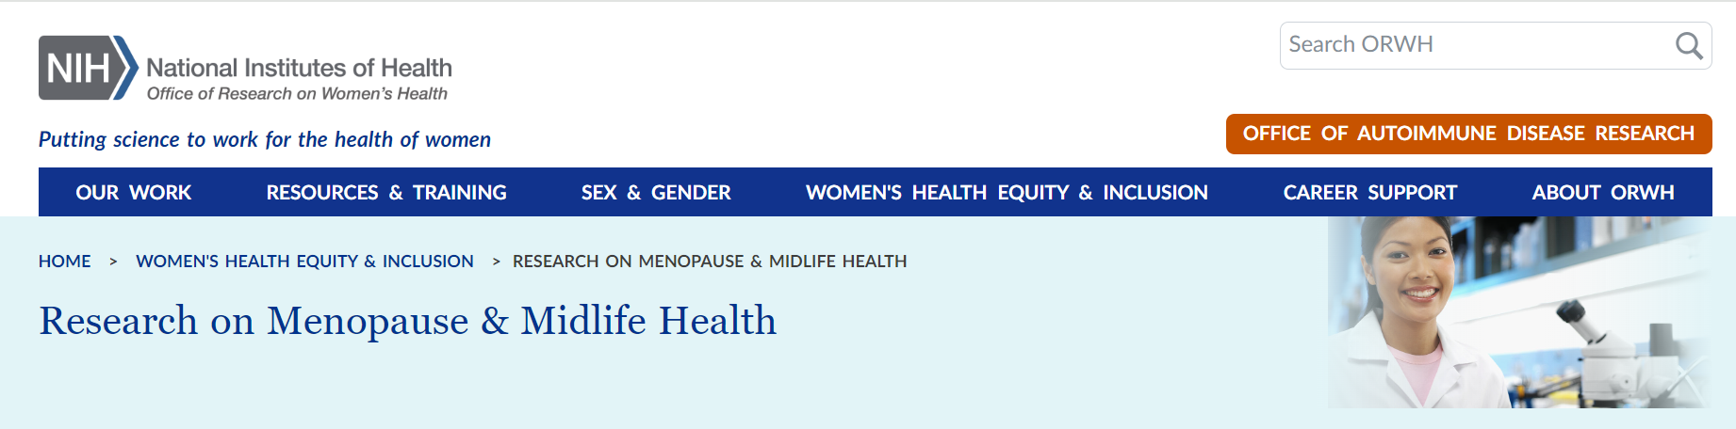


NIH Efforts Support Menopause Research and Women
https://orwh.od.nih.gov/womens-health-equity-inclusion/research-on-menopause-midlife-health
Pathways to Prevention
Read about My Menoplan: Evidence-Based Menopause Tool to Support Women
https://prevention.nih.gov/research-priorities/research-needs-and-gaps/pathways-prevention
https://mymenoplan.org/

